Slide 1
IBM University Engagement Project Submission
Name : T. Rohitha
Email ID : thogururohitha123@gmail.com
Domain of the Project : Education Technology

Slide 2

Project Title : Learn Mate AI – Personalized Course Pathway Agent
using IBM Granite
Domain of the Project:
Education Technology
Student Name | Recent Passport Photo | Email ID | Mobile number [WhatsApp]
T .Rohitha |  | thogururohitha123@gmail.com | 9392533470

Slide 3
Problem Statement : Agentic AI for Personalized Course Pathways
The Challenge :
Students often struggle to identify the right learning path because of the overwhelming number of online courses and lack of personalized guidance.
Many learners are confused about:
what skills to learn
which technologies are important
which projects to build
how to prepare for placements or career goals
The Objective :
Build an AI-powered Personalized Course Pathway Agent that:
Analyzes student interests and skill levels
recommends personalized learning roadmaps
suggests relevant skills, courses, and projects
provides career-focused guidance
dynamically adapts recommendations

Slide 4
Technology Used:
Tech Stack I used:
Python + Streamlit + IBM Granite Concepts
Technologies Used:
Python
Stream lit
JSON Knowledge Base
IBM Granite Concepts
Agentic AI Workflow

Slide 5
Proposed Solution :
The proposed solution is an AI-powered Personalized Course Pathway Agent that helps students identify the best learning roadmap based on their interests, skill levels, and career goals.
The system collects user inputs such as:
preferred domain
current skill level
career objective
Based on this information, the AI system generates:
recommended skills
learning roadmap
suggested courses
mini projects
career guidance
The solution uses Agentic AI concepts to create a dynamic and personalized educational assistant.
fusion and helping students focus on the right technologies and career path.

Slide 6
Langflow component Used :
1)Chat Input:
Allows users to enter:
interests
skill level
career goal
2) IBM Granite Concept:
Used for intelligent recommendation generation and personalized guidance
.
3) Recommendation Engine:
Analyzes user preferences and generates learning pathways
.
4) Chat Output:
Displays:
skills to learn
courses
projects
career suggestions
5) File Component:
Stores roadmap and recommendation data using JSON knowledge base.

Slide 7
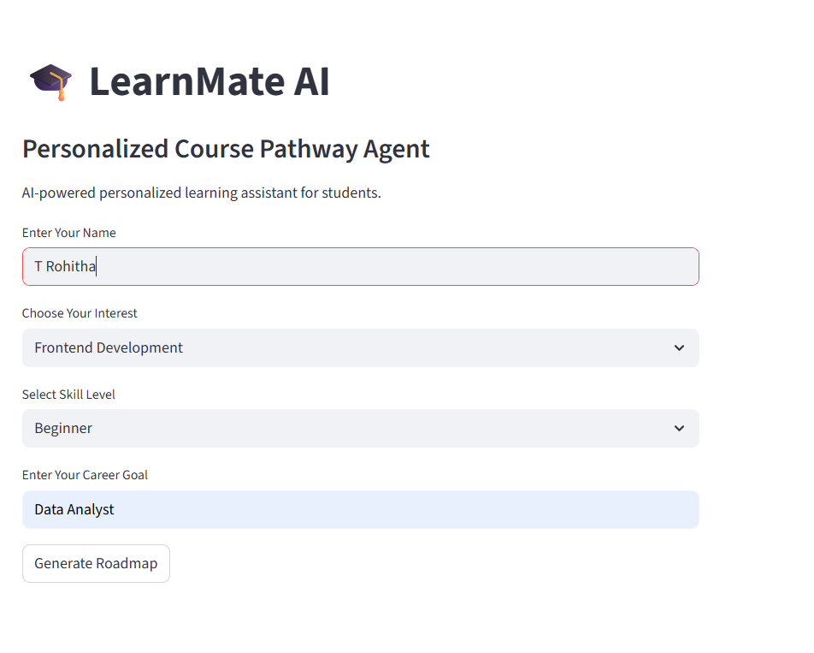
Lang flow workflow:
Workflow:
User Input ↓ Interest & Skill Analysis ↓ Recommendation Engine ↓ Personalized Roadmap Generation ↓ Course & Project Suggestions ↓ Career Guidance Output

Slide 8
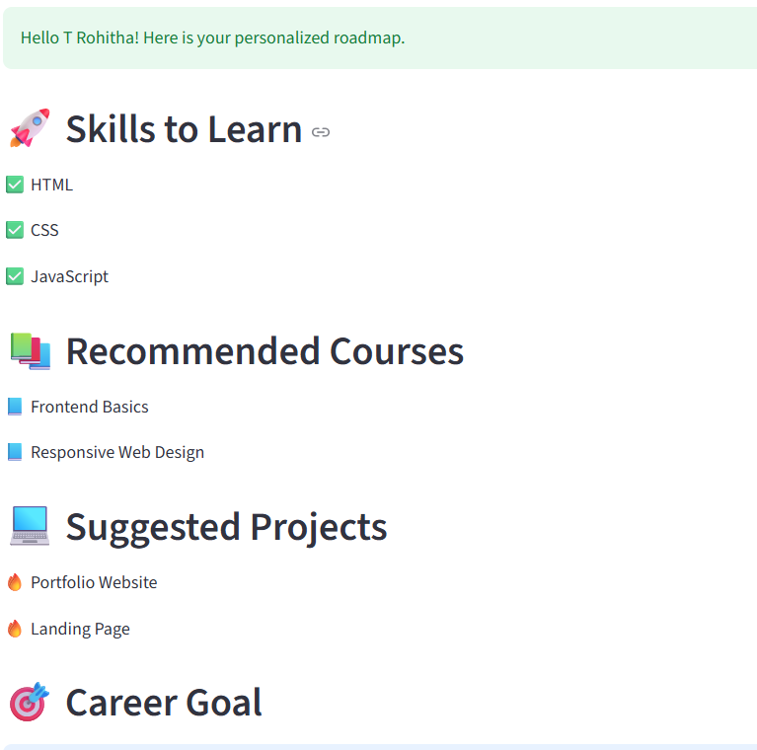
Role of Agentic AI in Learn Mate AI
Role of Agentic AI in Learn Mate AI
Agentic AI enables the system to function as an intelligent educational assistant instead of a basic chatbot.
The AI autonomously analyzes:
user interests
skill levels
career goals
and generates personalized learning pathways dynamically.
The system behaves like a smart mentor by:
recommending technologies
suggesting projects
guiding career preparation
adapting recommendations
This improves learning efficiency and helps students make better academic and career decisions.

Slide 9
Technology Used:
Streamlit:
Used for creating the interactive web interface.
Python:
Used for backend development and recommendation logic
.
IBM Granite Concepts:
Used for intelligent AI-based recommendation workflows.
JSON Knowledge Base
Used to store roadmap and course recommendation data
.
Agentic AI Workflow
Used for dynamic personalized guidance generation.

Slide 10
Novelty and Uniqueness:
Personalized Learning Roadmaps
AI-powered Course Recommendations
Career-focused Guidance
Beginner-Friendly User Interface
Dynamic Recommendation System
Education-Focused Agentic AI Solution
Project & Skill Suggestions in One Platform

Slide 11
Git Hub Link:
Learn Mate AI Project Git hub Link:
https://github.com/Rohitha970/LearnMate-AI.git
·
·
·
·

Slide 12
Future Scope
1.Integration with Online Learning Platforms:
The system can integrate with platforms like Coursera, Udemy, and IBM SkillsBuild to recommend real-time courses and certifications.
2. AI-Based Progress Tracking:
Future versions can monitor student progress and dynamically update learning pathways based on performance.
3. Resume & Placement Guidance:
The system can suggest resume improvements, mock interviews, and placement preparation strategies.
4. Multilingual Support:
Support for regional languages can improve accessibility for students from diverse backgrounds.
.
·
·
·

Slide 13
THANK YOU
Presented By:
Name: T. Rohitha
Department : Computer Science and Engineering
Email ID : thogururohitha123@gmail.com

